Slide 1


Introduction to Threads
Session

Slide 2
Review
Whenever an error is encountered while executing a program, an Exception occurs.
An Exception occurs at run time in a code sequence.
Every exception that is thrown must be caught, or the application terminates abruptly.
Exception handling allows combining error processing in one place.
Java uses the try and catch block to handle exceptions.
Java Simplified / Session 14 / <number> of 28

Slide 3
Review Contd…
The statements in the try block throw exceptions and the catch block handles them.
Multiple catch blocks can be used together to process various exception types separately.
The throws keyword is used to list the exception that a method can throw.
The throw keyword is used to indicate that exception has occurred.
The statements in the finally block are executed irrespective of whether an exception occurs or not.
Java Simplified / Session 14 / <number> of 28

Slide 4
Objectives
Define a thread
Define multithreading
List benefits of multithreading
Create threads
Discuss thread states
Manage threads
Explain how to set thread priorities
Describe a daemon thread
Java Simplified / Session 14 / <number> of 28

Slide 5
Multitasking Vs Multithreading
Multitasking is the ability to run one or more programs concurrently.
Operating system controls the way in which these programs run by scheduling them.
Time elapsed between switching of programs is minuscule.
Multithreading is the ability to execute different parts of a program called threads, simultaneously.
Java Simplified / Session 14 / <number> of 28

Slide 6
Thread
Thread is the smallest unit of executable code that performs a particular task.
An application can be divided into multiple tasks and each task can be assigned to a thread.
Many threads executing simultaneously is termed as Multithreading.
Appears that the processes are running concurrently, but it is not so.
Java Simplified / Session 14 / <number> of 28

Slide 7
Benefits of Multithreading
Multithreading requires less overhead than multitasking.
  In multitasking, processes run in their own different address space.
  Tasks involved in multithreading can share the same address space.
Inter-process calling involves more overhead than inter-thread communication.
Multithreading allows us to write efficient programs that make maximum use of CPU.
Multithreading allows animation loops to sleep for a second between each frame without causing the whole system to pause.
Java Simplified / Session 14 / <number> of 28

Slide 8



Applications of thread
Playing sound and displaying images simultaneously
Displaying multiple images on the screen
Displaying scrolling text patterns or images on the screen
Java Simplified / Session 14 / <number> of 28

Slide 9
Creating threads
When Java programs execute, there is always one thread running and that is the main thread.
  It is this thread from which child threads are created.
  Program is terminated when main thread stops execution.
  Main thread can be controlled through Thread objects.
  Reference of the main thread can be obtained by calling the currentThread() method of the Thread class.
Java Simplified / Session 14 / <number> of 28

Slide 10
Creating threads Contd…
Thread objects can be created in two ways:
  Declare a class that is a sub-class of the class Thread defined in java.lang package
      class mythread extends Thread
  Declare a class that implements the Runnable interface
      class mythread implements Runnable
While using applets, Thread class cannot be extended. Therefore one has to implement the Runnable interface.
Java Simplified / Session 14 / <number> of 28

Slide 11
Creating threads Contd…
After a new thread has been initiated, we use the start() method to start the thread otherwise it is an empty Thread object with no system resources allocated.
    Mythread t = new Mythread();
    t.start();
When start() method is invoked, the system resources required to run the thread is created and schedules the thread to run.
It then calls the thread’s run() method.
Java Simplified / Session 14 / <number> of 28

Slide 12
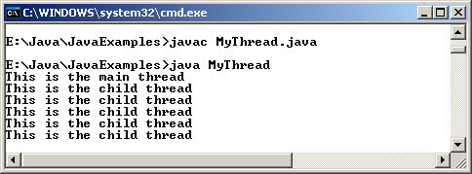
Creating threads Contd…
Example 1 –
Creating a thread by extending the Thread class
class MyThread extends Thread
{
public static void main(String args[])
{
MyThread Objex = new MyThread();
Objex.create();
System.out.println("This is the main thread");
}
public void create()
{
Thread Objth = new Thread(this);
Objth.start();
}
public void run()
{
while(true)
{
try
{
System.out.println("This is the child thread");
Thread.sleep(500);
}
catch(InterruptedException e)
{ }
}
}
}
Output
Java Simplified / Session 14 / <number> of 28

Slide 13
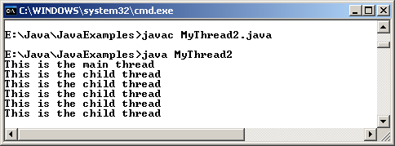
Creating threads Contd…
Example2 –
Creating a thread by implementing the Runnable interface
class MyThread2 implements Runnable
{
public static void main(String args[])
{
MyThread2 Objx = new MyThread2();
Objx.create();
System.out.println("This is the main thread");
}
public void create()
{
Thread Objth = new Thread(this);
Objth.start();
}
public void run()
{
while(true)
{
try
{
System.out.println("This is the child thread");
Thread.sleep(500);
}
catch(InterruptedException e)
{ }
}
}
}
Output
Java Simplified / Session 14 / <number> of 28

Slide 14


Thread states
Born: A newly created thread is in a born state.
Ready: After a thread is created, it is in its ready state waiting for start() method to be called.
Java Simplified / Session 14 / <number> of 28

Slide 15


Thread states Contd…
Running: Thread enters the running state when it starts executing
Sleeping: Execution of a thread can be halted temporarily by using sleep() method. The thread becomes ready after sleep time expires.
Java Simplified / Session 14 / <number> of 28

Slide 16



Thread states Contd…
Waiting: Thread is in waiting state if wait() method has been invoked. Used when two or more threads run concurrently.
Blocked: The thread enters a blocked state when it waits for an event such as Input/Output operations.
Dead: The thread enters the dead state after the run() method has finished or the threads stop() method is called.
Java Simplified / Session 14 / <number> of 28

Slide 17
Different thread states
New Thread
(BORN)
READY
SLEEPING
RUNNING
WAITING
BLOCKED
DEAD
Java Simplified / Session 14 / <number> of 28

Slide 18
Some methods of thread class
final boolean isAlive(): returns true if the thread is alive.
final String getName(): returns the name of the thread.
void start(): used to start a thread by calling the method run().
Java Simplified / Session 14 / <number> of 28

Slide 19
Some methods of thread class Contd…
final void join() throws InterruptedException: waits for the thread to die.
static void yield(): causes the currently executing thread to temporarily pause and allow other threads to execute.
final void setName(String name): sets the name of the thread to the name that is passed as an argument.
Java Simplified / Session 14 / <number> of 28

Slide 20
Some methods of thread class Contd…
final boolean isDaemon(): checks if the thread is a Daemon thread.
static int activeCount(): returns the number of active threads.
static void sleep(): used to suspend a thread for a certain period of time.
Java Simplified / Session 14 / <number> of 28

Slide 21
Conditions that prevent thread execution
If thread is:
  Not of highest priority
  Put to sleep using sleep() method
  Is waiting because wait() method was called
  Explicitly yielded using yield() method
  Blocked for file I/O
Java Simplified / Session 14 / <number> of 28

Slide 22
Managing threads
Priorities for carrying out activities changes at times
  eg :Planned to visit museum in the afternoon but due to toothache, had to go to doctor
Similarly while programming, we may have to run a thread of higher importance without stopping or suspending the current running thread
Thread priorities play an important role in such a situation.
Java Simplified / Session 14 / <number> of 28

Slide 23
Managing threads Contd…
Thread priorities in Java are constants defined in the Thread class.
    NORM_PRIORITY – value is
    MAX_PRIORITY – value is
    MIN_PRIORITY – value is
5
10
1
The default priority is NORM_PRIORITY
Two methods used to change priority:
    final void setPriority(int newp): changes the thread’s current priority.
    final int getPriority(): returns the thread’s priority.
Java Simplified / Session 14 / <number> of 28

Slide 24
Daemon threads
Two types of threads in Java:
  User threads: created by the user
  Daemon threads: threads that work in the background providing service to other threads
    e.g. – the garbage collector thread
When user thread exits, JVM checks to find out if any other thread is running.
If there are, it will schedule the next thread.
If the only executing threads are daemon threads, it exits.
Java Simplified / Session 14 / <number> of 28

Slide 25
Daemon threads Contd…
We can set a thread to be a Daemon if we do not want the main program to wait until a thread ends.
Thread class has two methods to deal with Daemon threads:
  public final void setDaemon(boolean value) : sets a thread to be a daemon thread
  public final boolean isDaemon() : checks if the given thread is a daemon thread
Java Simplified / Session 14 / <number> of 28

Slide 26
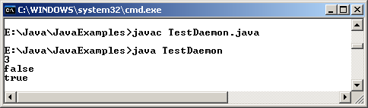
Daemon threads Contd…
class TestDaemon implements Runnable
{
Thread Objth1,Objth2;
public TestDaemon()
{
Objth1 = new Thread(this);
Objth1.start();
Objth2 = new Thread(this);
Objth2.setDaemon(true);
}
public void run()
{
System.out.println(Thread.activeCount());
System.out.println(Objth1.isDaemon());
System.out.println(Objth2.isDaemon());
}
public static void main(String args[])
{
new TestDaemon();
}
}
Output
Java Simplified / Session 14 / <number> of 28
An example

Slide 27

Multithreading and Garbage Collection

Slide 28
Review
Multithreading allows programmers to write efficient programs that make the maximum use of the CPU.
Java provides built-in support for multithreading in the form of classes and interfaces.
When Java programs are executed, there is already one thread that is running and it is the main thread. This main thread is important for two reasons:
  It is the thread from which child threads will be created.
  Program is terminated when the main thread stops execution.
Thread objects can be created in two ways:
  Declare the class to be a sub-class of the Thread class where we need to override the run() method of the Thread class.
  Declare a class that implements the Runnable interface. Then define the run() method.
Each thread in a Java program is assigned a priority, and the Java Virtual Machine never changes the priority of a thread.
Java Simplified / Session 14 / <number> of 28

Slide 29
Review Contd…
The default priority of a thread that is created is 5.
Two of the constructors in the Thread class are:
  public Thread(String threadname)
  public Thread( )
There are two types of threads in a Java program: User threads and Daemon threads.
  The threads created by the user are called user threads.
  The threads that are intended to be "background" threads, providing service to other threads are referred to as daemon threads.
The Thread class has two methods that deal with daemon threads.
  public final void setDaemon(boolean on)
  public final boolean isDaemon( )
Java Simplified / Session 14 / <number> of 28

Slide 30
Objectives
Use multithreading with applets
Use isAlive() and join()
Explain the need for synchronization
Discuss how to apply the keyword synchronized
Explain the role of the methods wait(), notify() and notifyAll()
Describe deadlocks
Describe garbage collection
Java Simplified / Session 14 / <number> of 28

Slide 31
Multithreading with applets
Some instances of using multithreading on the web are:
  Displaying scrolling marquees as banners
  Displaying clocks or timers as part of web pages
  Multimedia games
  Animated images
When an applet-based Java program uses more than one thread, it is called multithreading with applets.
Since Java does not support multiple inheritance, it is not possible to subclass the Thread class directly in Applets.
Java Simplified / Session 14 / <number> of 28

Slide 32
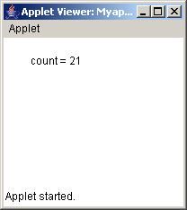
Example
/*
<applet code = Myapplet width = 200 height = 200>
</applet>
*/
import java.awt.*;
import java.applet.*;
public class Myapplet extends Applet implements Runnable
{
int count;
Thread objTh;
public void init()
{
objTh = new Thread(this);
objTh.start();
}
public void run()
{
for(count = 1; count <= 20; count++)
{
try
{
repaint();
Thread.sleep(500);
}
catch (InterruptedException e)
{}
}
}
public void paint(Graphics g)
{
g.drawString("count = "+count, 30, 30);
}
}
Output
Java Simplified / Session 14 / <number> of 28

Slide 33
Using isAlive() and join()
The main thread should be the last thread to finish.
We put the main thread to sleep for a long time within main() method and ensure that all the child thread terminate before main thread.
There are two ways to find out if a thread has terminated. They are:
  isAlive()
  join()
Java Simplified / Session 14 / <number> of 28

Slide 34
Example
class ThreadDemo implements Runnable
{
String name;
Thread objTh;
ThreadDemo(String str)
{
name = str;
objTh = new Thread(this, name);
System.out.println("New Threads are starting : " + objTh);
objTh.start();
}
public void run()
{
try
{
for (int count = 0;count < 2;count++)
{
System.out.println(name + " : "+count);
objTh.sleep(1000);
}
}
catch(InterruptedException e)
{
System.out.println(name + " interrupted");
}
System.out.println(name + " exiting");
}
public static void main(String [] args)
{
ThreadDemo Objnew1 = new ThreadDemo("one");
ThreadDemo Objnew2 = new ThreadDemo ("two");
ThreadDemo Objnew3 = new ThreadDemo ("three");
System.out.println("First thread is alive :" + Objnew1.objTh.isAlive());
System.out.println("Second thread is alive :" + Objnew2.objTh.isAlive());
System.out.println("Third thread is alive :" + Objnew3.objTh.isAlive());
try
{
System.out.println("I am in the main and waiting for the threads to finish");
Objnew1.objTh.join();
Objnew2.objTh.join();
Objnew3.objTh.join();
}
catch(InterruptedException e)
{
System.out.println("Main thread is interrupted");
}
System.out.println("First thread is alive :" + Objnew1.objTh.isAlive());
System.out.println("Second thread is alive :" + Objnew2.objTh.isAlive());
System.out.println("Third thread is alive :" + Objnew3.objTh.isAlive());
System.out.println("Main thread is over and exiting");
}
}
Java Simplified / Session 14 / <number> of 28

Slide 35
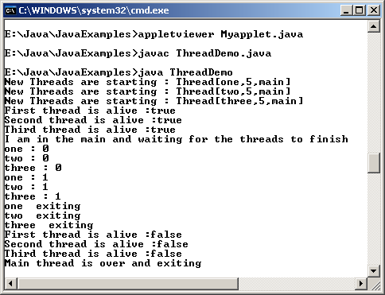
Example Contd…
Output
Java Simplified / Session 14 / <number> of 28

Slide 36
Thread Synchronization
At times, two or more threads may try to access a resource at the same time.
  For example, one thread might try to read data from a file while another one tries to change the data in the same file
In such a case, data may become inconsistent.
To ensure that a shared resource is used by only one thread at any point of time, we use synchronization.
Java Simplified / Session 14 / <number> of 28

Slide 37
Thread Synchronization Contd…
Synchronization is based on the concept of monitor.
A monitor is an object that is used as a mutually exclusive lock.
Only one thread can enter a monitor.
When one thread enters the monitor, it means that the thread has acquired a lock and all other threads must wait till that thread exits the monitor.
For a thread to enter the monitor of an object, the programmer must invoke a method created using the synchronized keyword.
Owner of the method has to exit from the method to give up the control.
Java Simplified / Session 14 / <number> of 28

Slide 38
Example
class One
{
synchronized void display(int num)
{
System.out.print(""+num);
try
{
Thread.sleep(1000);
}
catch(InterruptedException e)
{
System.out.println("Interrupted");
}
System.out.println(" done");
}
}
class Two implements Runnable
{
int number;
One objOne;
Thread objTh;
public Two(One one_num, int num)
{
objOne = one_num;
number = num;
objTh = new Thread(this);
objTh.start();
}
public void run()
{
objOne.display(number);
}
}
class SynchMethod
{
public static void main(String args[])
{
One objOne = new One();
int digit = 10;
Two objSynch1 = new Two(objOne,digit++);
Two objSynch2 = new Two(objOne,digit++);
Two objSynch3 = new Two(objOne,digit++);
//wait for threads to end
try
{
objSynch1.objTh.join();
objSynch2.objTh.join();
objSynch3.objTh.join();
}
catch(InterruptedException e)
{
System.out.println("Interrupted");
}
}
}
Java Simplified / Session 14 / <number> of 28

Slide 39
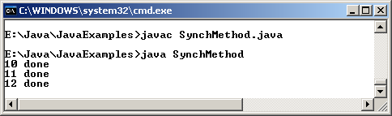
Example Contd..
Output
Java Simplified / Session 14 / <number> of 28

Slide 40
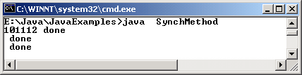
Race condition
If synchronized keyword is omitted from the previous example, all the threads can simultaneously invoke the same method, on the same object.
This condition is known as race condition.
Race conditions in a program are possible when
  Two or more threads share data
  They are reading and writing the shared data simultaneously
Output
Without
Synchronization
Java Simplified / Session 14 / <number> of 28

Slide 41
Synchronized Block
It is not always possible to achieve synchronization by creating synchronized methods within classes.
We can put all calls to the methods defined by this class inside a synchronized block.
A synchronized block ensures that a method can be invoked only after the current thread has successfully entered object’s monitor.
The example shown earlier can be modified with the synchronized keyword used in the method run() of the class ‘One’.
Java Simplified / Session 14 / <number> of 28

Slide 42
Using ‘wait-notify’ mechanism
Java provides well designed inter-process communication mechanism using the wait(), notify() and notifyAll() methods.
The methods are implemented as final methods in the class Object.
wait(), notify() and notifyAll() can be called only from within a synchronized method.
Java Simplified / Session 14 / <number> of 28

Slide 43
Using ‘wait-notify’ mechanism Contd…
wait() method tells the calling thread to exit and enter the sleep state till some other thread enters the monitor and calls the notify() method.
notify()method wakes up the first thread that called wait().
notifyAll() wakes up or notifies all the threads that called wait().
Once all the thread are out of sleep mode, the thread that has the highest priority will run first.
Java Simplified / Session 14 / <number> of 28

Slide 44


Using ‘wait-notify’ mechanism Contd…
notify()
First thread
notify() wakes up or notifies the first thread.
notifyAll()
Thread 2
notifyAll() wakes up or notifies all the threads that called wait( ) on the same object.
Thread 1
Thread 3
Java Simplified / Session 14 / <number> of 28

Slide 45
wait()
Points to remember while using the wait() method:
  The calling thread gives up the CPU.
  The calling thread gives up the lock.
  The calling thread goes into the waiting pool of the monitor.
Java Simplified / Session 14 / <number> of 28

Slide 46
notify()
Main points to remember about notify():
  One thread moves out of the waiting pool of the monitor and into the ready state.
  The thread that was notified must reacquire the monitor’s lock before it can proceed since it was in sleep state and no longer had the control of the monitor.
Java Simplified / Session 14 / <number> of 28

Slide 47
Example
class ChopStick
{
boolean available;
ChopStick()
{
available = true;
}
public synchronized void takeup()
{
while(!available)
{
try
{
System.out.println("Philosopher is waiting for the other chopstick");
wait();
}
catch(InterruptedException e)
{ }
}
available = false;
}
public synchronized void putdown()
{
available = true;
notify();
}
}
class Philosopher extends Thread
{
ChopStick left,right;
int philo_num;
Philosopher(int num, ChopStick chop1,ChopStick chop2)
{
philo_num = num;
left = chop1;
right = chop2;
}
public void eat()
{
left.takeup();
right.takeup();
System.out.println("Philosopher "+(philo_num+1)+" is eating");
}
public void think()
{
left.putdown();
right.putdown();
System.out.println("Philosopher "+(philo_num+1)+" is thinking");
}
Java Simplified / Session 14 / <number> of 28

Slide 48
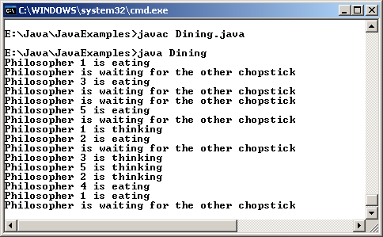
Example Contd…
public void run()
{
while(true)
{
eat();
try
{
sleep(1000);
}
catch(InterruptedException e)
{}
think();
try
{
sleep(1000);
}
catch(InterruptedException e)
{}
}
}
}
//end of class
class Dining
{
static ChopStick[] chopsticks = new ChopStick[5];
static Philosopher[] philos = new Philosopher[5];
public static void main(String args[])
{
for (int count = 0;count <= 4;count++)
{
chopsticks[count] = new ChopStick();
}
for (int count = 0;count <= 4;count++)
{
philos[count] = new Philosopher(count,chopsticks[count],chopsticks[(count+1)%5]);
}
for (int count = 0;count <= 4;count++)
philos[count].start( );
}
}
Output
Java Simplified / Session 14 / <number> of 28

Slide 49
Deadlocks
Occurs when two threads have a circular dependency on a pair of synchronized objects.
  For example: one thread enters the monitor on object ‘ObjA’ and another thread enters the monitor on object ‘ObjB’.
  If the thread in ‘ObjA’ attempts to call any synchronized method on ‘ObjB’, a deadlock occurs.
Java Simplified / Session 14 / <number> of 28

Slide 50
Example
public class DeadlockDemo implements Runnable
{
public static void main(String args[])
{
DeadlockDemo objDead1 = new DeadlockDemo();
DeadlockDemo objDead2 = new DeadlockDemo();
Thread objTh1 = new Thread (objDead1);
Thread objTh2 = new Thread (objDead2);
objDead1.grabIt = objDead2;
objDead2.grabIt = objDead1;
objTh1.start();
objTh2.start();
System.out.println("Started");
try
{
objTh1.join();
objTh2.join();
}
catch(InterruptedException e)
{
System.out.println("error occurred");
}
System.exit(0);
}
DeadlockDemo grabIt;
public synchronized void run()
{
try
{
Thread.sleep(500);
}
catch(InterruptedException e)
{
System.out.println("error occurred");
}
grabIt.syncIt();
}
Java Simplified / Session 14 / <number> of 28

Slide 51
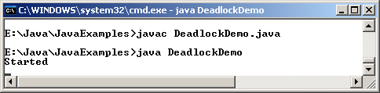
Example Contd…
public synchronized void syncIt()
{
try
{
Thread.sleep(500);
System.out.println("Sync");
}
catch(InterruptedException e)
{
System.out.println("error occurred");
}
System.out.println("In the syncIt() method");
}
}// end class
Output
Java Simplified / Session 14 / <number> of 28

Slide 52

Garbage collection
It is a process whereby the memory allocated to objects, which are no longer in use, may be reclaimed or freed.
Java automatically frees the memory that is no longer required.
Thus programmers do not have to worry about garbage collection at all.
An object becomes eligible for garbage collection if there are no references to it or if it has been assigned to null.
Java Simplified / Session 14 / <number> of 28

Slide 53
Garbage Collection Contd…
Garbage collector runs as a separate low priority thread.
Garbage collector can be invoked by invoking that instance’s gc () method.
There is no guarantee that garbage collection will take place right then.
Java Simplified / Session 14 / <number> of 28

Slide 54
Using the finalize method
Java provides a way that is similar to C++ destructors, which can be used for cleaning up process before the control returns to the operating system.
The finalize() method if present will be executed prior to garbage collection only once per object. Syntax of the method is:
  protected void finalize() throws Throwable
Referrences cannot be garbage collected; only objects are.
Java Simplified / Session 14 / <number> of 28

Slide 55
Example
class GCDemo
{
public static void main(String args[])
{
int count;
long num;
Runtime objRun = Runtime.getRuntime();
Long values[] = new Long[200];
System.out.println("Amount of free memory is " + objRun.freeMemory());
objRun.gc();
System.out.println("Amount of free memory after garbage collection is "+ objRun.freeMemory());
for(num = 10000,count = 0; count < 200; num++,count++)
{
values[count] = new Long(num);
}
System.out.println("Amount of free memory after creating array is "+ objRun.freeMemory());
for (count = 0;count < 200 ; count++)
{
values[count] = null;
}
objRun.gc();
System.out.println("Amount of free memory after garbage collection is "+ objRun.freeMemory( ));
}
}
Java Simplified / Session 14 / <number> of 28

Slide 56
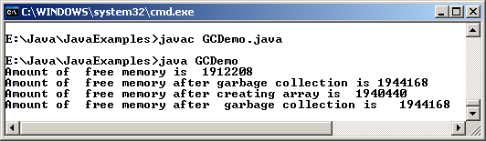
Example Contd…
Output
Java Simplified / Session 14 / <number> of 28

Slide 57
Summary
Data may get corrupted when two or more threads access the same variable or object at the same time.
The method isAlive() returns true if the thread upon which it is called is still running.
The method join() will wait until the thread on which it is called terminates.
Synchronization is a process that ensures that the resource will be used by only one thread at a time.
Synchronization does not provide any benefit for single threaded programs. In addition, their performance is three to four times slower than their non-synchronized counterparts.
The method wait() tells the calling thread to give up the monitor and enter the sleep state till some other thread enters the same monitor and calls the method notify().
Java Simplified / Session 14 / <number> of 28

Slide 58
Summary Contd…
The method notify() wakes up or notifies the first thread that called wait() on the same object.
The method notifyAll() wakes up or notifies all the threads that called wait() on the same object.
A deadlock occurs when two threads have a circular dependency on a pair of synchronized objects.
Garbage collection in Java is a process whereby the memory allocated to objects, which are no longer in use, may be reclaimed or freed.
The garbage collector runs as a low priority thread and we can never predict when it will collect the objects.
Java Simplified / Session 14 / <number> of 28

